Slide 1
Patient Management Application
ADD
READ
UPDATE
DELETE

Slide 2
4 Design Steps:
Identify the resources
Create the URIs to access those resources
Assign the HTTP methods
Choose the data format

Slide 3
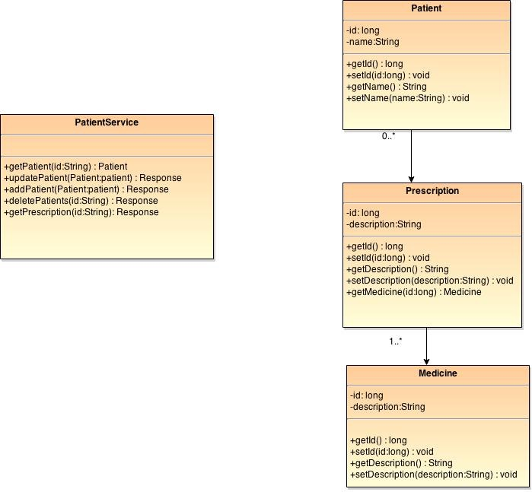

Slide 4
Creating URIs
Creating a Patient
/patients
READING Patient
/patients/{id}
Updating Patient
/patients
Removing Patient
/patients/{id}

Slide 5
HTTP METHODS
GET
POST
PUT
DELETE

Slide 6
Data Format
Read Request:
/patients/123
Read Response:
<Patient>
<id>123</id>
<name>Bharath</name>
</Patient>

Slide 7
Create:
<Patient>
<name>Bharath</name>
</Patient>
Create Response:
<Patient>
<id>124</id>
<name>Bharath</name>
</Patient>

Slide 8
Update Request:
<Patient>
<id>124</id>
<name>Bharath</name>
</Patient>
Update Response:
HTTP/1.1 200 OK

Slide 9
Delete Request:
/patients/123
Delete Response:
HTTP/1.1 200 OK

